Slide 1
Client and Tenant Satisfaction Measures Survey
What survey?
Hightown Housing Association have commissioned Acuity, a market research company who specialise in the social housing sector, to carry out a series of surveys with their residents. The survey is a general satisfaction survey (perception survey) asking residents what they think about their home and the services provided by Hightown Housing Association. The questions are based on the Tenant Satisfaction Measures (TSMs) introduced by the Regulator of Social Housing from April 2023.
Who are Acuity?
Acuity Research & Practice (Acuity) provide resident satisfaction surveys and benchmarking services, helping housing providers to improve services and engage with their residents through an understanding of satisfaction, performance and profiling data. They have been providing consultancy services to the social housing sector for over 26 years.
Who will be contacted?
Acuity will contact Hightown Housing Association residents by sending an online link via email or text from 11th November 2024 or by telephone from 2nd December. A postal survey will be sent to scheme managers to distribute to Care & Supported Housing residents only from 11th November. The survey should take approximately 8 to 10 minutes to complete. The survey only needs to be completed once.
What number to look out for?
If you received a call Acuity the number displayed will be 01442 xxxxxx, which is a Local Area code.

Slide 2
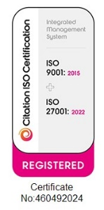
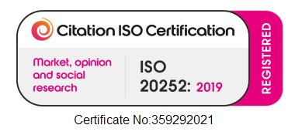
When will we call your residents?
Acuity only make calls between the hours of 9:00am and 20:00pm Monday to Friday and between the hours of 10.00am and 18:00pm on Saturday. Interviewers allow the telephone to ring for a minimum of 25 seconds, or until a voice mail system kicks in, to ensure customers with mobility issues are given sufficient time to get to the phone.
What telephone number is displayed?
If a resident receives a call from Acuity the number displayed is 01442 xxxxxx, which is a Local Area code. If the resident sees a missed call from this number and calls back, they will hear a recorded message informing them that someone from Acuity tried to call them to complete a survey for their landlord.
What can I do to help residents and boost response rates?
It is really important that front line staff encourage residents to take part at every opportunity and assist residents with queries about the survey and reassure them that the calls are genuine.
Is the survey confidential and anonymous?
The survey is strictly confidential and if a resident requests, the results can be given back to Hightown Housing Association anonymously without their name attached.
Is the survey in line with data protection and what about quality standards?
All the calls are recorded for training and quality purposes. Acuity is a company partner member of the Market Research Society and is registered with the Information Commissionaires Office, and in line with the Data Protection Act is not permitted to release any details to any other organisation. Under the Data Protection Act Acuity is not permitted to release any information that would allow an individual to be identified without their prior active consent to do so. All research projects are carried out in conformity with ISO20252:2019 which is the quality standard for market research companies, Acuity is company member of the Market Research Society and adheres to the MRS Code of Conduct.
Who should I contact at Hightown Housing Association or Acuity if I have a query that is not addressed here?
If you have any queries about any of the survey, please contact xxx at Hightown Housing Association (email xxx, tel xxx) or Heather Metivier at Acuity (01273 287114 or helpdesk@arap.co.uk).
Want to know more about Acuity?
Acuity Research & Practice Limited, www.arap.co.uk

